Slide 1
Wireless Local Area Network

Slide 2
Wireless Local Area Network(WLAN)
A wireless local area network (WLAN) is a wireless computer network that links two or more devices using wireless communication within a limited area such as a home, school, computer laboratory, or office building
The networks that cover a distance of 10-500m are called WLAN.
The network that cover offices and buildings about 50-500 m distance and require communication between different database servers, wireless nodes, printers, etc.
WLAN are gaining significant importance in business and academic environments.
A WLAN is sometimes call a local area wireless network (LAWN).
It use high-frequency radio waves.

Slide 3
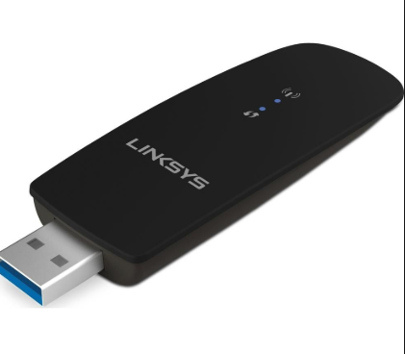
WLAN Components
wireless adapters
A device that adds wireless connectivity to a laptop or desktop computer. All of the adapters below are available as external USB modules that plug into an empty slot on the motherboard.
They usually contain the functionalities of physical and data link layers.
They enable end-user to access the network.
Adapter create a transparent connection to the network in a WLAN.

Slide 4
Continue…
wireless Access Points
In a wireless local area network (WLAN), an access point is a station that transmits and receives data .
An access point connects users to other users within the network and also can serve as the point of interconnection between the WLAN and a fixed wire network.
Each access point can serve multiple users within a defined network area; as people move beyond the range of one access point, they are automatically handed over to the next one.
A small WLAN may only require a single access point.
AP covers a range of 20-500 m, and a single AP can support between 15 and 250 users, depending upon the technology, configuration and use.
An access point is a device that creates a wireless local area network, or WLAN, usually in an office or large building.
An access point connects to a wired router, switch, or hub via an Ethernet cable, and projects a Wi-Fi signal to a designated area.
For example, if you want to enable Wi-Fi access in your company's reception area but don’t have a router within range, you can install an access point near the front desk and run an Ethernet cable through the ceiling back to the server room.

Slide 5
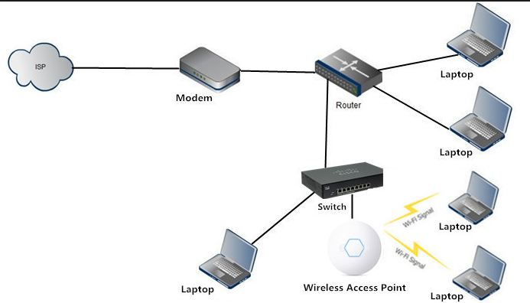
Continue…
Example of Access Points

Slide 6
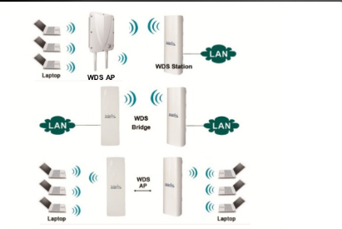
Continue…
Outdoor WLAN Bridge:
Outdoor bridge are used to connect wired LANs in different buildings. The cost of deploying a fiber optic cable between buildings such as highways, bodies of water, valley, etc. In such situations, a WLAN bridge can be an economical alternative. A bridge can also provide a less expensive alternative to recurring leased-line charges. WLAN bridge supports fairly high data rates and covers ranges of several miles with the use of line-of-sight directional antennas. Some Aps can also be used as a bridge between buildings of relatively close proximity.

Slide 7
Continue…
WLAN Routers
A router is a device that forwards data packets between computer networks.
Router use internet protocol packet header and routing tables, as well as Ips to determine the best path for each packet.
A wireless router helps you not just enjoy your part of the internet, but it also helps you to complete all your work whenever you feel like as internet is available all the time. Instead of the connection hassle, you can use the wireless router and connect your internet with your phones, computers, tablets and laptops. With just one connection, you can connect many devices.
With a wireless router, there is a different IP address for every device connected with the same internet so that every gadget is easily connected with the internet.
Advantages:
It share IP address at the home and in small office network. Areas, especially, if there are multiple networks that are accessible.
Multiple connections get easy with wireless routers
Routers only send packets to specific addresses.
It improve the network management.
WLAN routers are ideal for wireless networks in public
Wireless router will let you access the Internet easily without any involvement of wires. Now you can use the Internet using wireless routers 24/7.

Slide 8
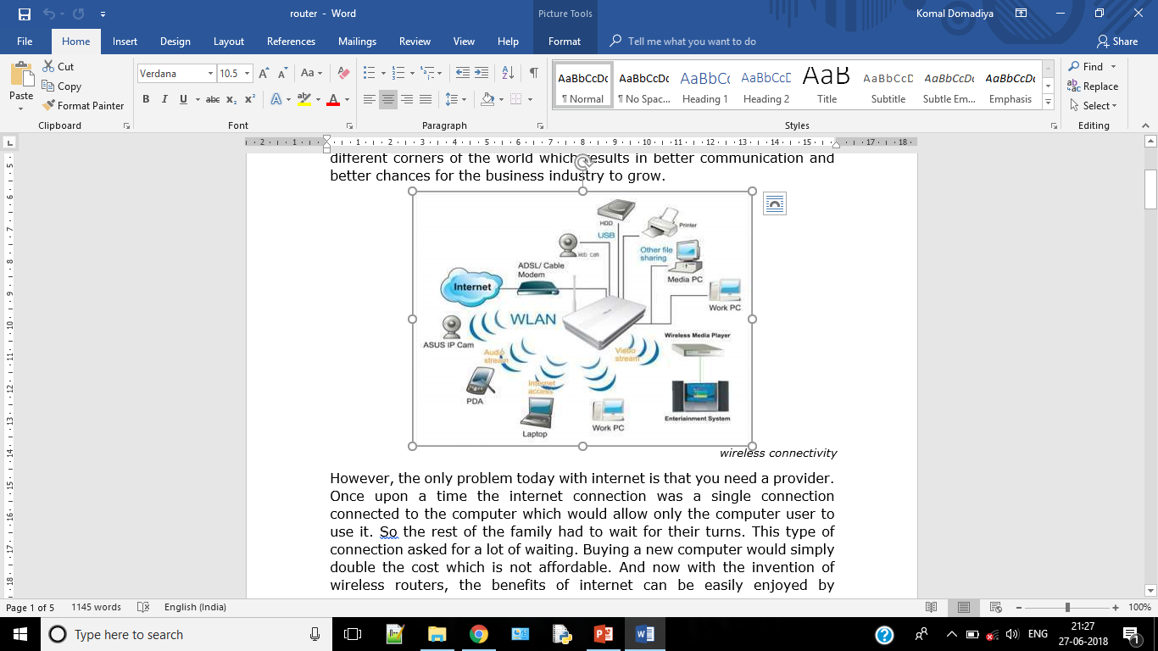

Slide 9
WLAN Network Architecture
There are two modes of WLANs:
Infrastructure-based
Infrastructure less

Slide 10
WLAN Standards
The Institute of Electrical and Electronic Engineers (IEEE) has developed official standards to enable wireless local area network (WLAN) devices to work together, regardless of which manufacturer made them.
These standards were driven by two factors:
speed - getting data transmitted faster between PCs and access points
security - making sure that the wireless capability is not abused
You need to be aware of both factors when choosing WLAN equipment.
WLAN devices operate with the IEEE 802.11 standard.

Slide 11
IEEE 802.11
IEEE 802.11 is a set of standards for a WLAN.
The standard is better known as Wi-Fi.
This is a collection of standards that build on the earlier IEEE standards for LANs.
The original 802.11 standard was published in 1997.
This standard provided a data speed of 1 or 2 Mbit/s.
The standard operates in the nearly worldwide available 2.4 GHz band ranging from 2400 - 2483.5 MHz.
The standard uses either frequency hopping or coding technology to make the transmissions robust.
All the 802.11 specifications use the Ethernet protocol for path sharing. The original modulation used in 802.11 was phase-shift keying (PSK).

Slide 12
IEEE 802.11a
IEEE 802.11a is an amendment to the 802.11 standard for wireless LANs. It is of the specifications that is more commonly known as Wi-Fi.
Also known as IEEE 802.11a-1999
Not as common as 802.11b
More expensive than 802.11b equipment.
802.11a uses radio frequencies in the 5 GHz band and supports theoretical throughput of up to 54 Mbps.
Shorter range, about 75feet

Slide 13
IEEE 802.11b
Very common and inexpensive
Communicates on the 2.4GHz frequency
Maximum data transmission rate of 11Mbps
Indoor range of about 300feet
Weak security
Its capacity is 32 users per AP.
Its range is quite large and used range matters rather then the density.
It normally installed in both business and homes for easiest migration between the two locations, also being deployed in “hot spots” such as hotels, airports ect.

Slide 14
IEEE 802.11e
802.11e modifies current 802.11 MAC layer to support quality of service to multimedia applications.
It is a proposed enhancement to the 802.11q and 802.11b wireless LAN specifications.
It offers quality of service features, including the prioritization of data, voice and video transmissions.
Business and consumer products using 802.11e are expected to become widely available in late 2004 or in 2005.
802.11e offers subscribers high speed internet access with voice over internet protocol and high quality audio.
This standards also provides interoperability between home, business and public environments.
Networks using 802.11e operate at radio frequencies ranging between 2.4GHz and 2.4835GHz or between 5.75GHz and 5.850GHz.
This higher frequency ranges accounts for advantages such as more channels, fast data transfer speeds and less chances of interference.

Slide 15
IEEE 802.11f
This is still under development.
It also know as Inter-Access Point Protocol.
IEEE 802.11F is a recommendation that describes an optional extension to IEEE 802.11 that provides wireless access point communications among multivendor systems.
It promises to let users move through an extended wireless LAN having multiple APs from different vendors and maintaining the connection.

Slide 16
IEEE 802.11g
It combine the both 802.11a and 802.11b.
Developed in 2003
Supports bandwidth up to 54 Mbps.
Use 2.4 GHz frequency.
Good indoor range of about 150 feet
Improved security.
802.11g is backward compatible with 802.11b
Low price point.
Disadv
Speed decreases as the distance increase.

Slide 17
IEEE 802.11h
This standards is still under development.
It enhances the 802.11 MAC standard and 802.11a high speed PHY layer in the 5 GHz band.
It solves problems like interference with satellites and radar using the same 5 GHz frequency band.
It was originally designed to address European regulations but is now applicable in many other countries.
It has been integrated into the full IEEE 802.11-2007 standard.

Slide 18
IEEE 802.11n
IEEE 802.11n is a wireless-networking standard that uses multiple antennas to increase data rates.
802.11n is four to five times faster then 802.11a or 802.11g, and perhaps 20 times faster then 802.11b.
Data transmission rate of 100Mbps.
IEEE 802.11n builds on previous 802.11 standards by adding multiple-input multiple-output (MIMO) and security improvements, among other features.
It can be used in the 2.4 GHz or 5 GHz frequency bands.

Slide 19
IEEE 802.11p
IEEE 802.11p is an approved amendment to the IEEE 802.11 standard to add wireless access in vehicular environments (WAVE).
It defines enhancements to 802.11 required to support Intelligent Transportation Systems (ITS) applications.
This includes data exchange between high-speed vehicles and between the vehicles and the roadside infrastructure, so called V2X communication, in the licensed ITS band of 5.9 GHz (5.85-5.925 GHz).
802.11p will be used for the dedicated short range communications for vehicular environment for vehicle-based communication networks, particularly for applications such as toll collection, vehicle safety services, and communication transactions via cars. The ultimate vision is a nationwide network that enables communication between vehicles and roadside Aps or other vehicles.

Slide 20
WLAN Applications
A home area network (HAN) is a network that is deployed and operated within a small boundary, typically a house or small office/home office
There are four specific approaches that companies have been taking in the development of home networks: wiring a home with ethernet cabling, phonelines, power lines and wireless devices for internet.
Many of the industry see wireless as the single most effective technology for integrating into a home.
The possible applications that can be networked are television, radio, VCD player, PDAs, laptop, desktop etc.
Home networking allows interconnection among the multimedia content devices.
The home is connected to outside world through a broadband link.
A HAN also may include other devices, such as a fax, printer, scanner or small network attached storage that is shared by all host devices.

Slide 21
WLAN Applications
Home Area Network
Deployed and operated within a small boundary
Most effective technology.
The possible applications of HAN
Allows interconnection.
Outside world connection is also possible.
All devices are connected via AP.
It use ADSL and DSL method.
Benefits of HAN
Accessibility
Security
Resources sharing
Security
Cost saving
Multiple users

Slide 22
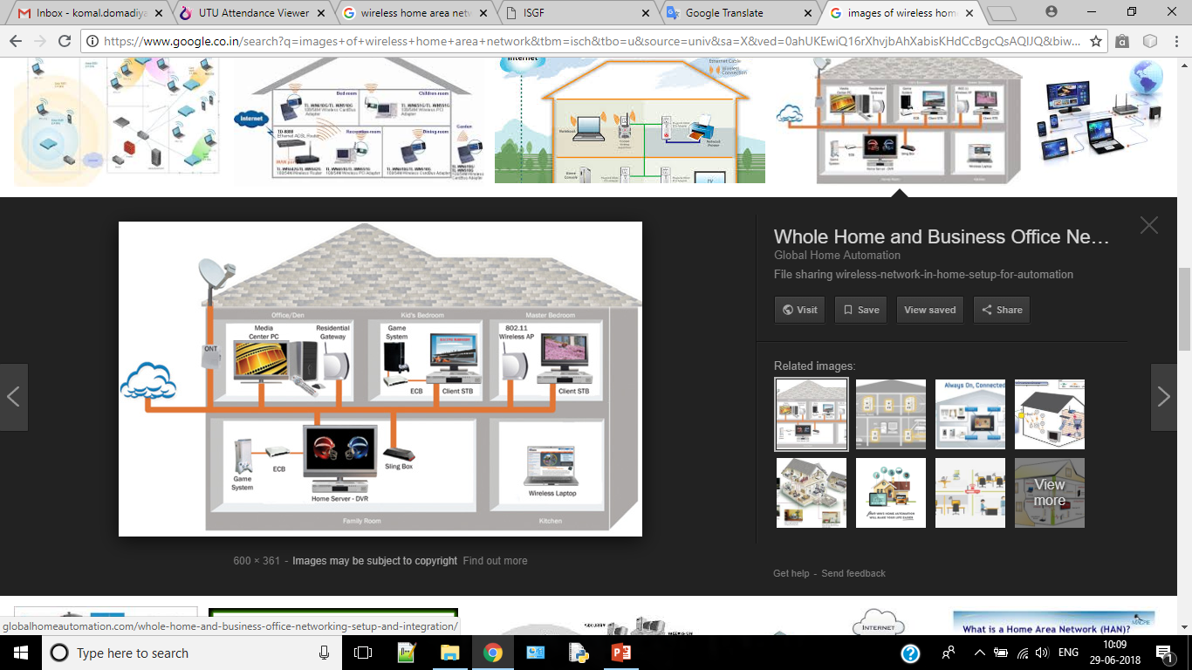
Cont.

Slide 23
Designing Requirements of WLAN
Range and coverage
Throughput
Integrity and reliability
Compatibility
Interoperability
Licensing issues
Security
Cost
Scalability
Battery life
safety

Slide 24
DCF and PCF
BSS : Basic Service Set
SS : Source Station
NAV: Network Allocation Vector
MAC: Medium Access Control
CSMA/CA: Career Sense Multiple Access/Collision Avoidance
CSMA/CD: Career Sense Multiple Access/Collision Detection
PCS: Physical Career Sensing(Sense)
VCS: Virtual Career Sensing(Sense) RTS/CTS: Request to Send/Clear to Send
MPDU: Message Protocol Data Unit
SIFC: Short Interframe space
DCF: Distributed Coordination Function
PCF: Point Coordination Function
CFP: Contention-free period

Slide 25
DCF and PCF
What is DCF:
Fundamental access method
Infrastructure less technique
Operates ac hoc network
Based on CFMA/CA
802.11 specifies two ways for determine the medium is busy or not
PCF VCF

Slide 26
DCF and PCF
What is PCF:
Use poll and response protocol
Point coordination controls the PCF
PC located in AP

